Slide 1
PHOTO EDITING - Development
CSE 611 – MS Project Development
Professor – Jinjun Xiong

Slide 2
TEAM MEMBERS
Pavana Lakshmi Venugopal
Saad Ahmed
Taraka Rohit Adusumilli
Ayesha Humaera

Slide 3
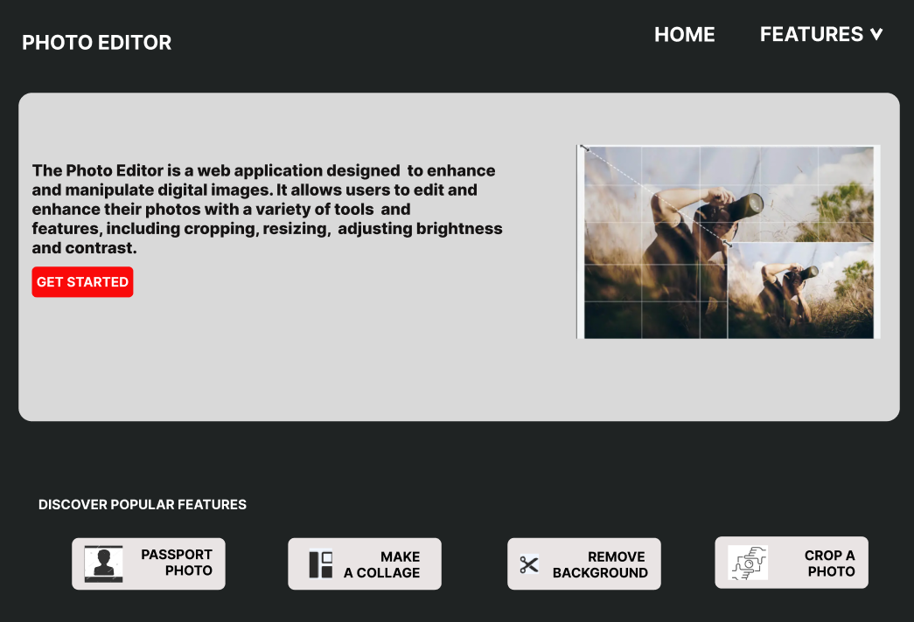
Wireframe Home Page
‹#›

Slide 4
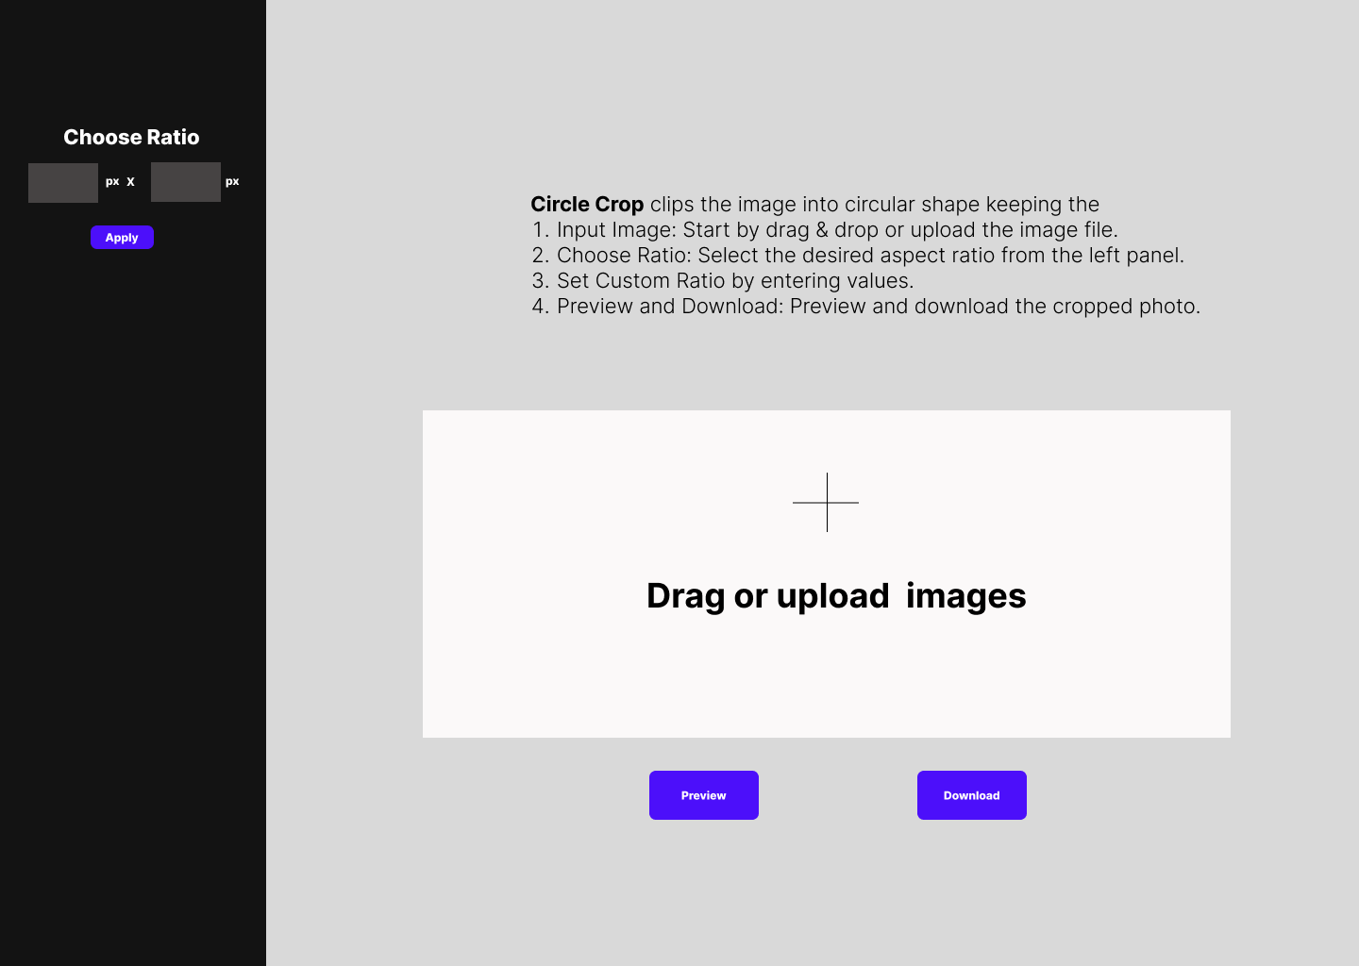
Circle Crop
‹#›

Slide 5
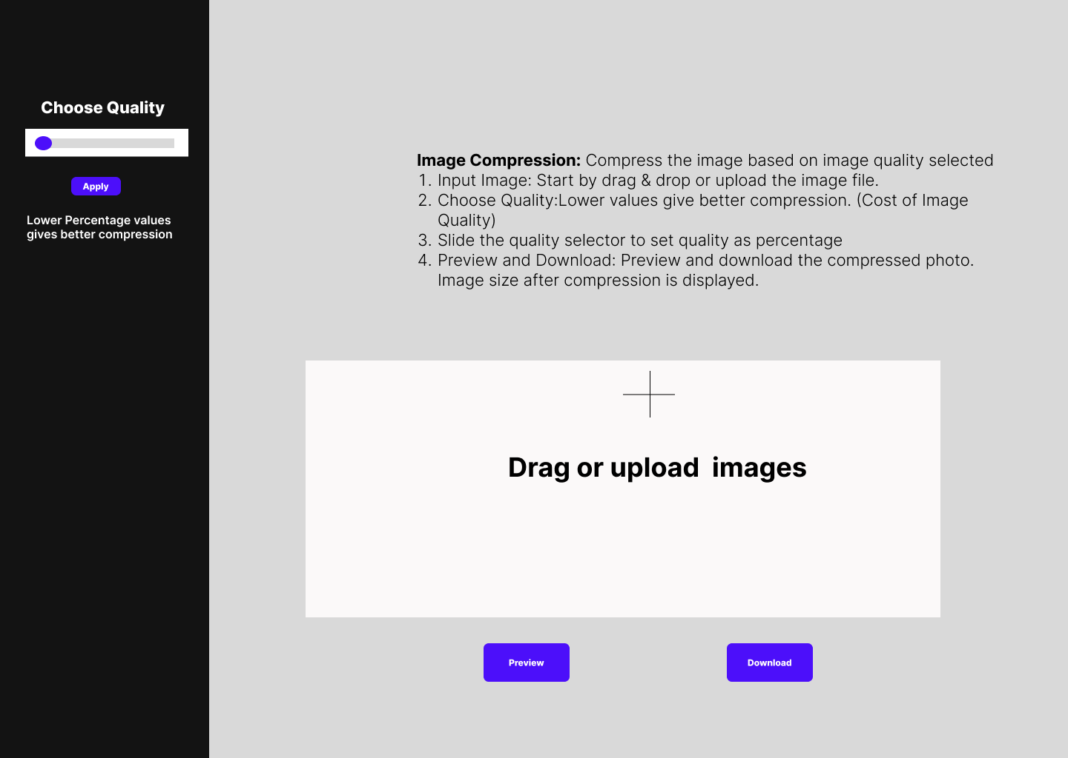
Image Compression
‹#›

Slide 6
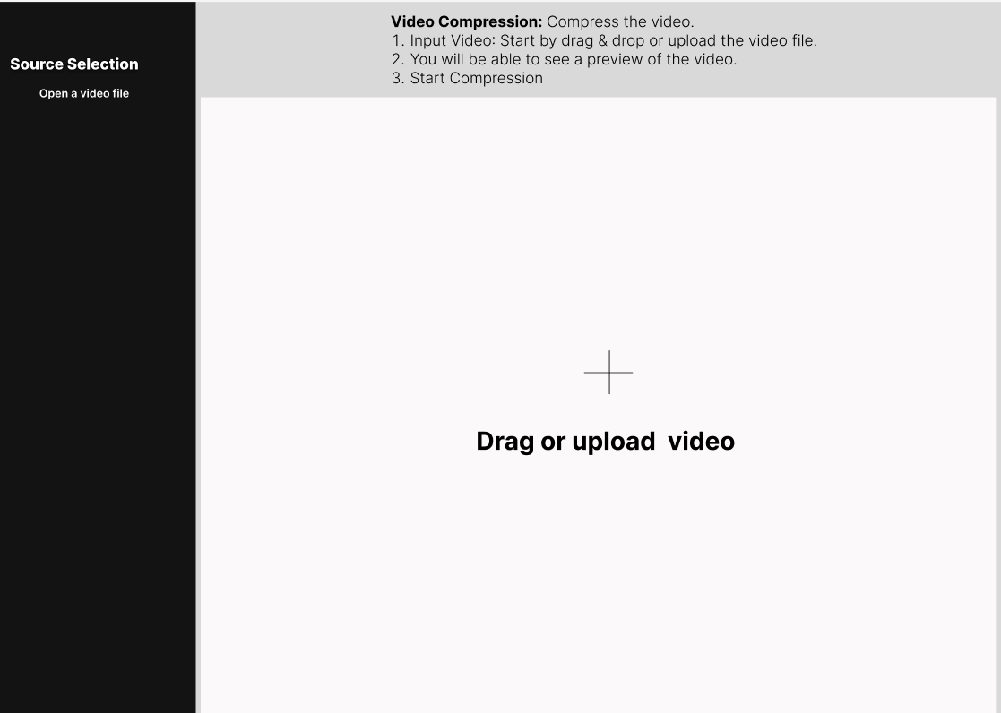
Video Compression

Slide 7
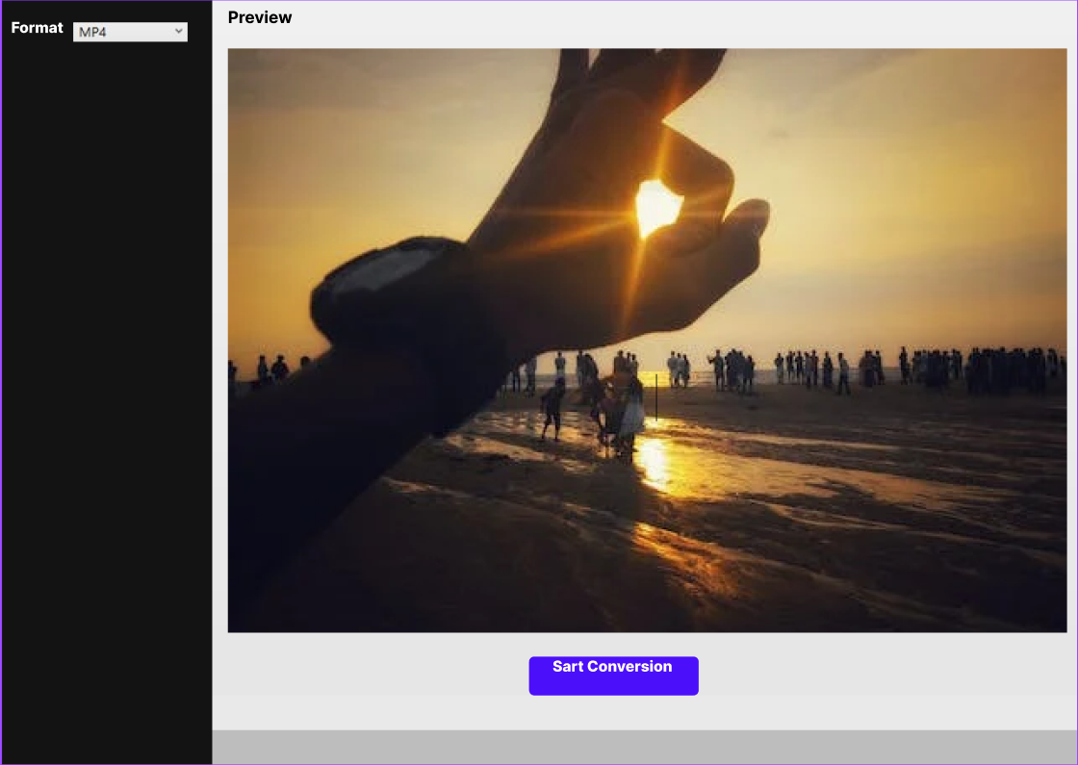

Slide 8
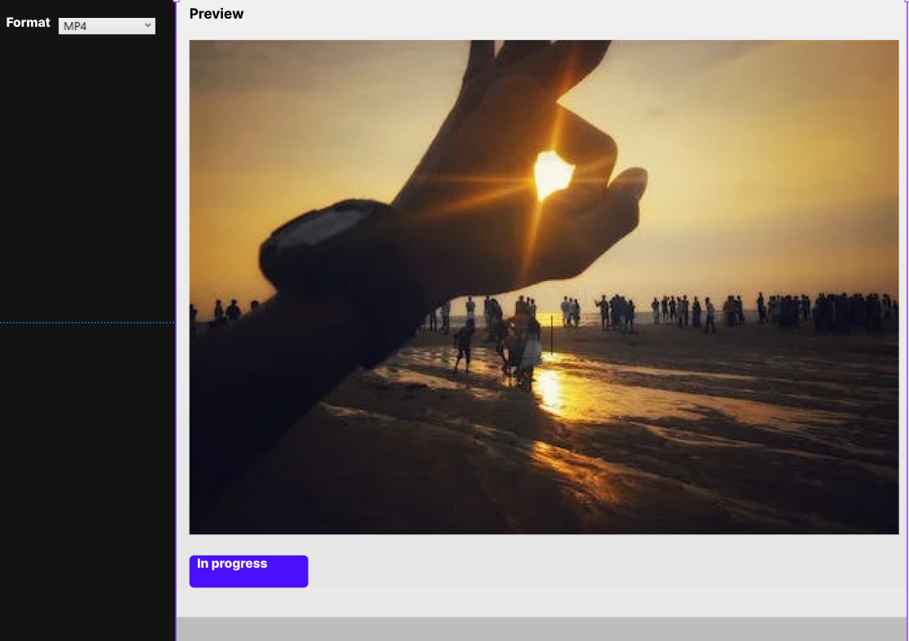

Slide 9
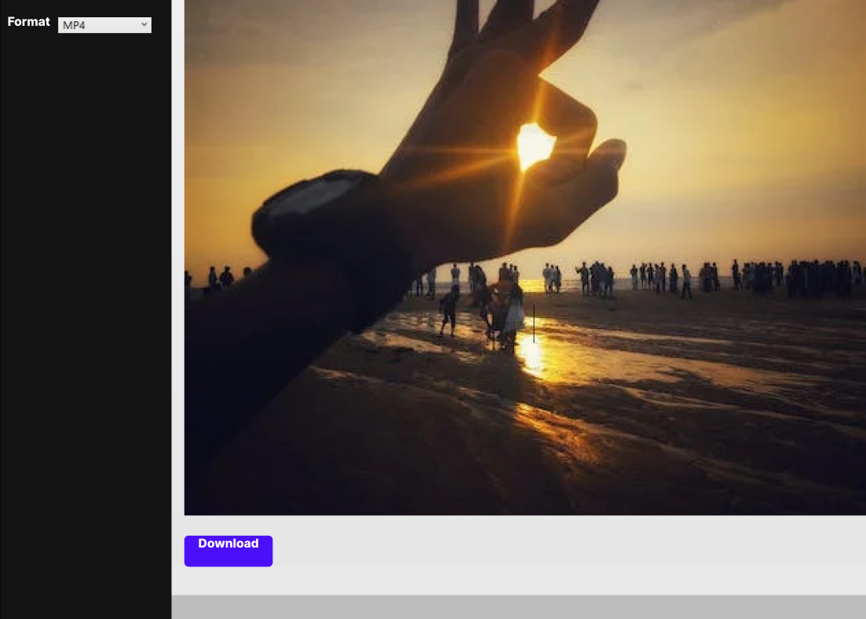

Slide 10
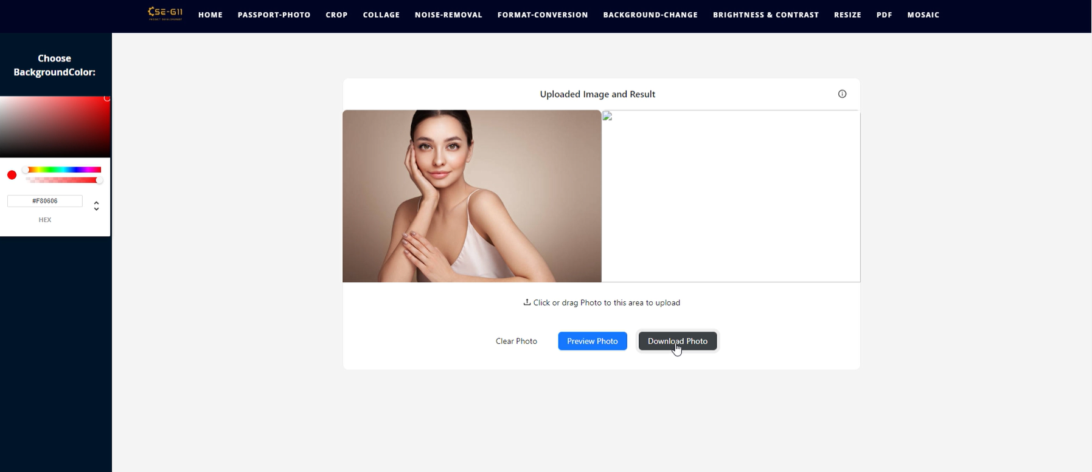
Background change - Before Fix

Slide 11
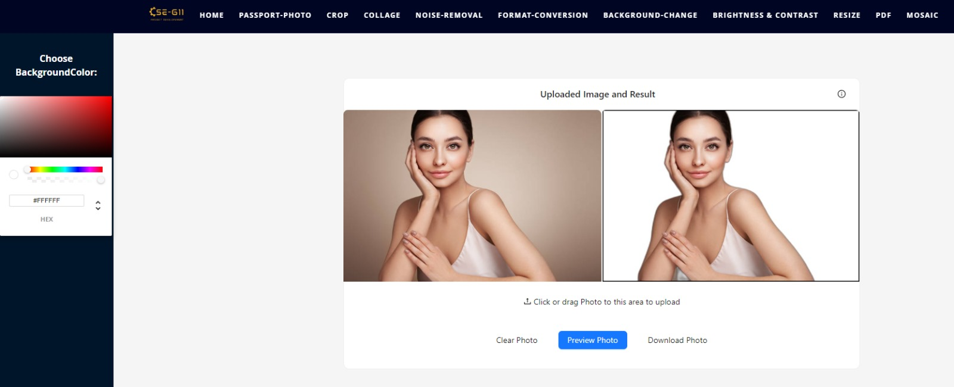
Background change - After Fix

Slide 12
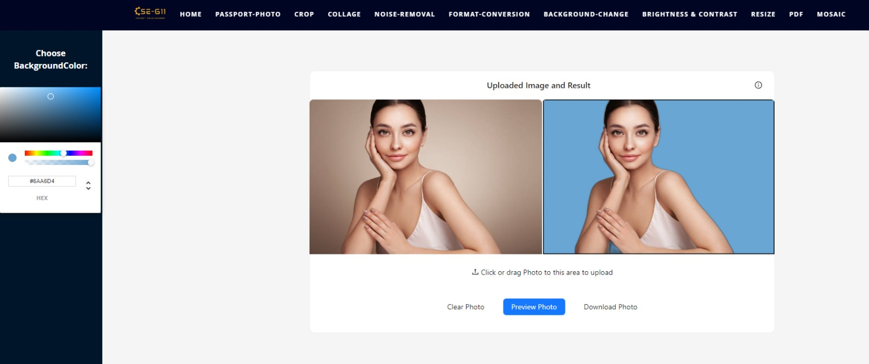

Slide 13
Wireframe Review & Direction
Wireframe Overview
Presents a skeletal visualization of our User Interface (UI).
Previously shown wireframes showcase the layout for both the home page and feature pages of our Photo Editor.
Main Page Highlights
a. Feature Cards
Multiple cards detailing each feature.
Each card is accompanied by a concise explanation of its functionality.
b. Navigation & Flow
Clicking on any feature card leads to its respective feature page.
Intuitive layout ensures easy user navigation.
Notes:
‹#›

Slide 14
Wireframe Review & Direction
Feature Page Layout
a. Options Panel
Positioned to the left.
Contains specific controls related to the chosen feature.
b. Image Interaction
Located to the right.
Allows users to upload, preview the edited image, and download it seamlessly.
Direction Forward
Upholding the existing UI design due to its proven effectiveness.
Prioritizing User Experience (UX) enhancements to ensure a smoother and more intuitive journey for our users.
Notes:
‹#›

Slide 15
Progress on Image Compression
Image Compression Research & Implementation
Research Overview
Investigated various methodologies for efficient image compression.
Prioritized methods that strike a balance between compression efficiency and image quality.
Identified Techniques
a. Pillow Library
Simple and straightforward method using the quality parameter for JPEG images.
Suitable for a wide variety of image file formats.
Notes:
‹#›

Slide 16
Progress on Image Compression
Identified Techniques
a. Pillow Library
Simple and straightforward method using the quality parameter for JPEG images.
Suitable for a wide variety of image file formats.
b. Deep Learning Models
Advanced models designed for high-quality image compression.
Preserves image quality even at higher compression rates.
c. Specialized Compression Libraries
Tools such as imageio, opencv, and tinyPNG.
Offer advanced compression algorithms and options.
d. Dynamic Compression
Analyzes image content for region-specific compression.
Maintains details in vital areas, compressing others more aggressively.
Notes:
‹#›

Slide 17
Progress on Image Compression
Did some POC work just to understand how I can implement Image Compression.
Next Steps
Develop the feature within our Flask backend, allowing users to compress images effectively.
Continuously monitor user feedback to ensure the quality and efficiency of our solution.
Notes:
‹#›

Slide 18
Report on UI Bugs
Compile time error for Passport Photo page
Initially, the error pointed out a missing property 'rev' within the type definitions.
Fixed by adding a 'rev' component to fulfill the requirement of the 'Pick<AntdIconProps' type.
Pushed the change to github.
Scroll to bottom and scroll to top arrows on home page not working.
Tested on different browsers,
On Edge, menu-bar is not rendering properly
Slide icon on the left side of each feature page is not working as expected

Slide 19
Thank you

